Slide 1




MATH 201 – Fall 2024
Linear Algebra and Vector Geometry
Image Compression: Fourier and Wavelet Transforms
Group
Abdelrahman Abdelghany – 202301000
Mostafa Mahmoud – 202300905
Yehya Saied – 202301237
Martin Rober – 202301070
Mohamed Hossam – 202300556

Slide 2
Abstract
♠ The Fourier Transform, introduced by Fourier in 1822, decomposes functions into frequencies, and is widely used in image compression.
♠ Image compression reduces file sizes by removing data (either lossy or lossless).
♠ This presentation explores the application of Fourier and Wavelet transforms in compressing images.

Slide 3
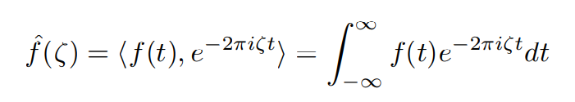
Fourier Transform
♠ Projects functions onto a basis of sines and cosines.
♠ Provides a frequency spectrum analysis of signals.
♠ Applied in various fields like seismic activity detection, signal analysis and image compression.
The Fourier Transform is given by

Slide 4
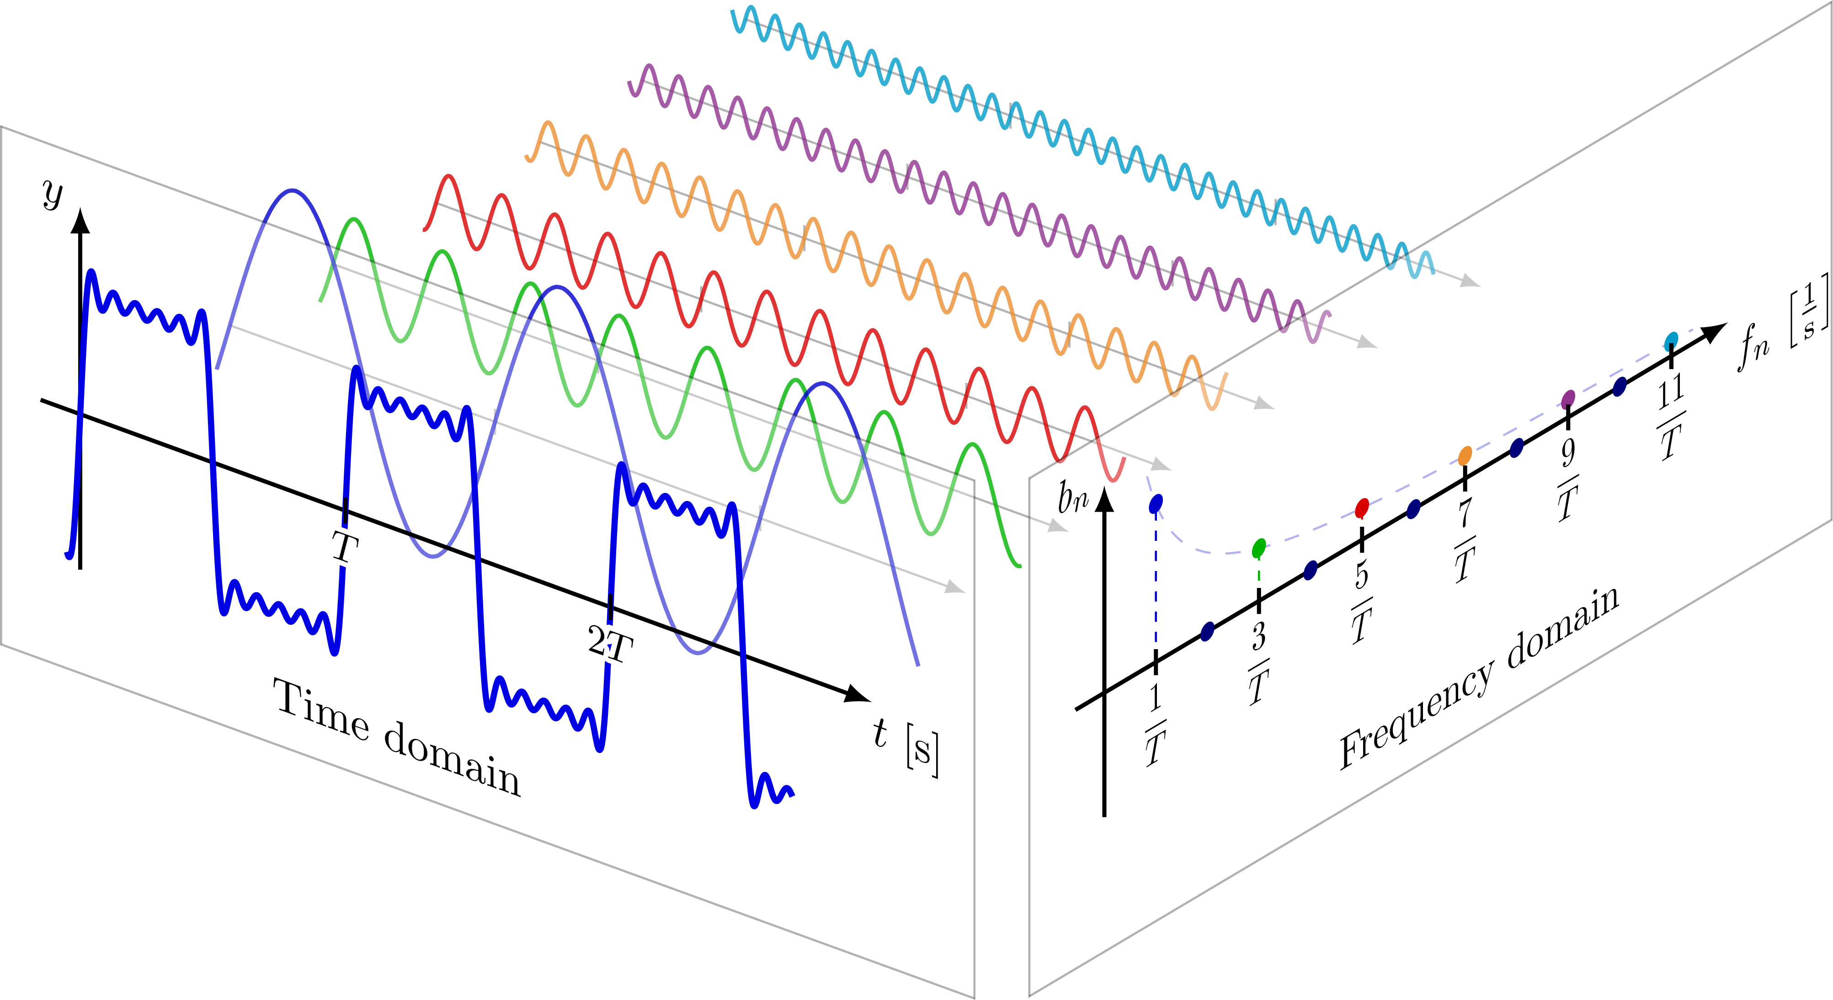
Why use Fourier Transform?
The answer is that the ability to analyze a waveform into pure frequencies is nearly indispensable in many fields
We are going to see how it deals with
Image Compression

Slide 5
Image compression
Image compression is the act of compressing an image as the cost of fidelity. Essentially, the file’s size is decreased as a result of removing data stored within the image. That data is usually what gives the image its sharp looks.
Image compression process is split into 5 stages in the program.

Slide 6
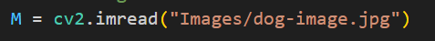
Stage 1: Converting the Image into a Color Matrix
At the beginning, the program reads the image that is provided and transcribes the RGB values into a matrix.

Slide 7

Stage 2: Fourier Transforming the Color Matrix
We take fast Fourier transformation (FFT).

Slide 8
Stage 3: The Compression Process
First, the program discards all the values with a magnitude less than the tolerance
Then it starts sorting by magnitude
Then it finds the threshold value based on the percentage of the largest data to keep (K)
Then it zeros out all the values below the threshold

Slide 9
Stage 4: Inverse Fourier Transforming the Color Matrix
After it takes the Inverse Fast Fourier Transformation (IFFT), It takes the real part to get rid of the tiny complex bits.

Slide 10
Stage 5: Converting the Color Matrix Into an Image
Finally, It writes the compressed data to an image.

Slide 11
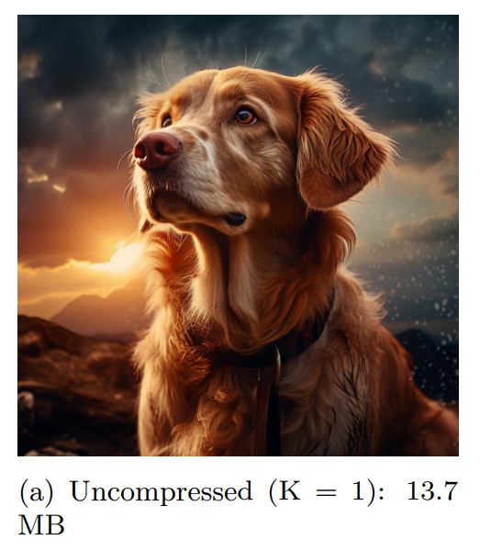
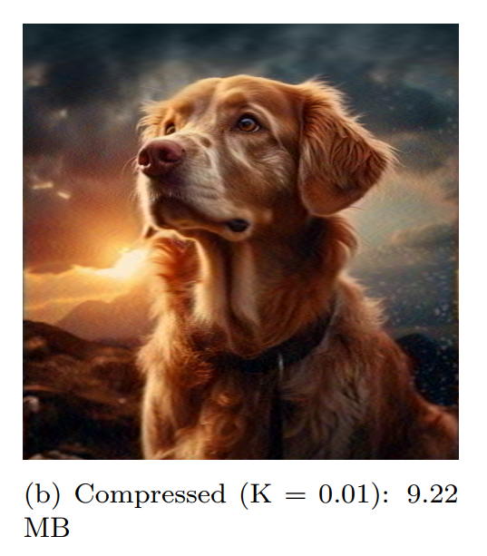
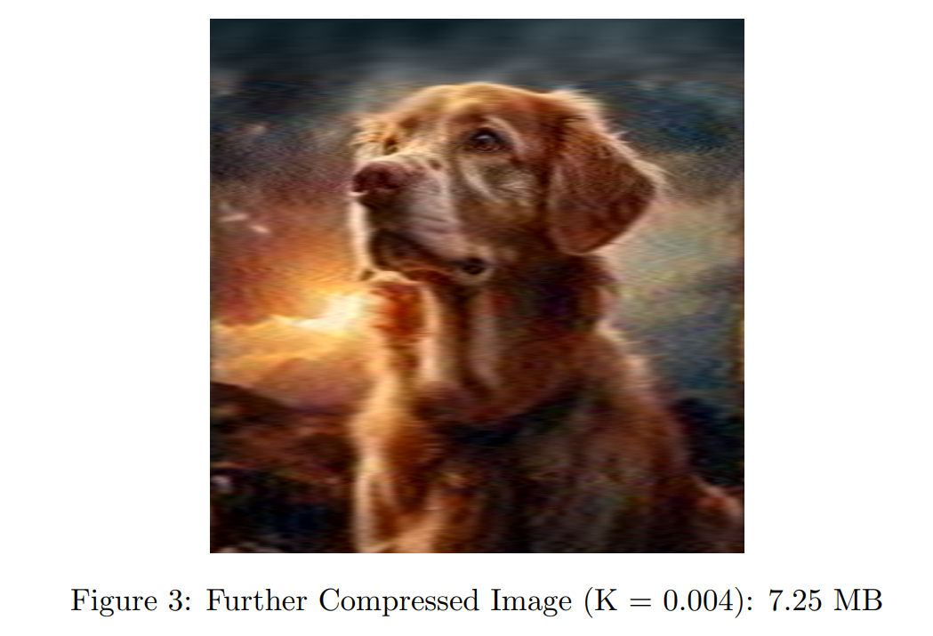
Results

Slide 12
We are going to discuss another method using the Wavelet Transform
♠ Decomposes signals into localized wave packets.
♠ Better handles chaotic and irregular signals.
♠ Provides both time and frequency resolution.
♠ Suitable for complex real-world data.

Slide 13
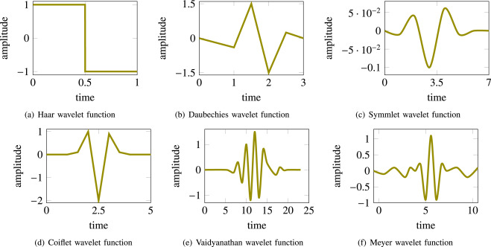
Why use Wavelet Transform?
The image compression process is much the same as the Fourier transform process. However, one stage differs slightly.

Slide 14
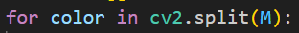
Stage 1.5: Splitting the Color Channels
The only difference is in splitting the color channels in the following line of the program code.

Slide 15
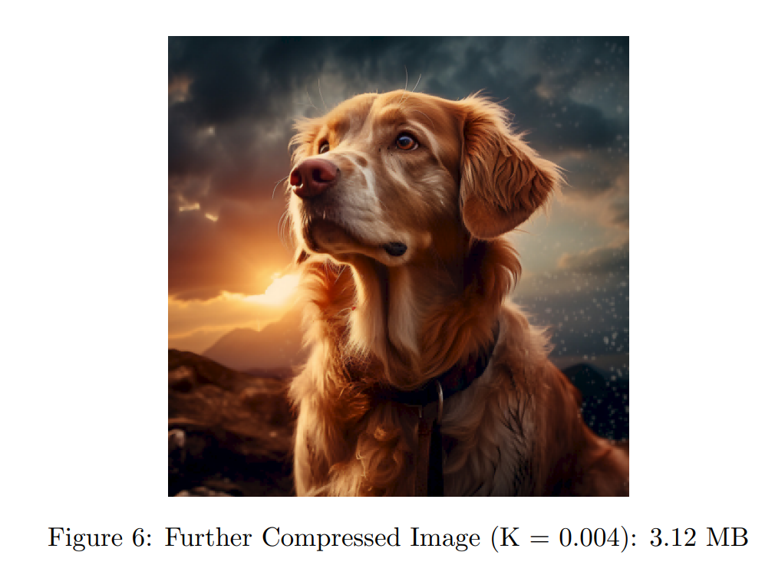
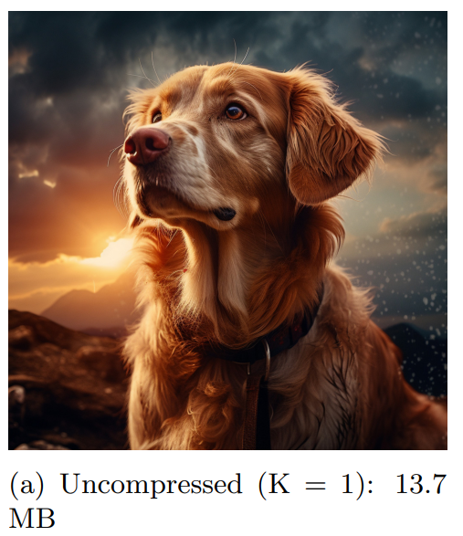
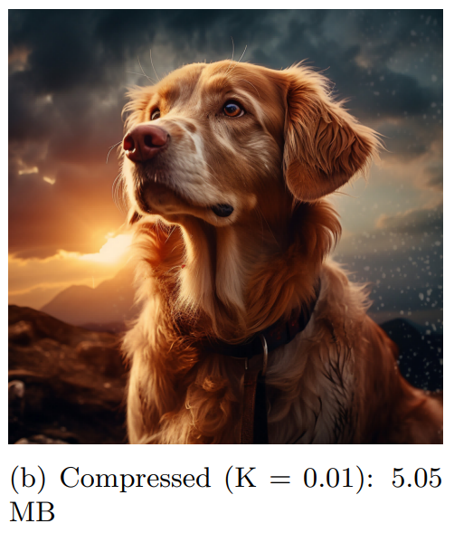
Results

Slide 16
Now lets make a comparison between both methods
For the Fourier Transform, the image was spoiled, with artifacts all over, just for a ≈ 1.9 times size reduction.
While on the other hand, the Wavelet Transform has been reduced in size from the corresponding Fourier transform compression by ≈ 2.3 times!!

Slide 17
Conclusion
Evidently, both the Fourier and Wavelet transforms are quite powerful means of compressing images in a lossy manner. However, the Wavelet transform provides better results for the same keep (K) ratios, both in fidelity and image size. This is because the Wavelets used are comprised of short bursts of energy which are localized in time, which better approximate a signal that is as chaotic and messy as real signals are. For this cause, Wavelet transforms are considered extremely powerful, and are used almost routinely in image compression algorithms.

Slide 18
THANK YOU!!

